Slide 1


MetaCommerce - The Future of Shopping with Metaverse
Team Name: Coders Inc.
Institute Name: Netaji Subhas University of Technology

Slide 2

Team members details
Team Name | Coders Inc.
Institute Name | Netaji Subhas University of Technology
Team Members > | 1 (Leader) | 2
Name | Rohan Sharma | Harshit Mittal
Batch | 2024 | 2024

Slide 3
Deliverables/Expectations for Level 2 (Idea + Code Submission)
The solution should focus on:
Building a web-based metaverse using out-of-the-box Avatar generation tools for users to enter and experience. HInt - Existing open source solutions can be used.
Building a shared 3D space on the web that is shared concurrently by many users. Hint- Any existing 3D spaces can be used.
We are listing a few feature suggestions below - Feel free to use a part or all of them in your experience Or additional features can be added too. The idea is to build a next-gen futuristic Metaverse Shopping experience.
Ability to view products in 3D in the shared spaces and AR as well (You may allow users to scan a QR code to view products in AR on their phone)
Ability to try-on apparels etc on the Avataar.
Bonus- Add-to-cart/checkout of the product
Bonus- Voice chat with fellow shoppers, enablement of camera
Bonus- Use your imagination and create innovative experiences.

Slide 4
Glossary
Describe/ Expand abbreviations if you have used any in the slides below

Slide 5
Instructions (You Can Delete this Slide)
Dear Team,
Congratulations on reaching this stage - We look forward to some amazing & innovative solutions.
Please find some important instructions before you begin to prepare your submission decks.
Slide Limit : 10 Slides of Content post (after) this Slide
Saving Format : Save the file as a PDF to ensure your formatting remains intact
Submission Guide: Only the ‘Team Leader’ will be able to submit the Deck.
Only the latest submission will be considered as final
(You can keep updating your deck within the deadline)
Wishing you all the very best !
Team Flipkart GRiD

Slide 6
Flipkart Cyberspace
Welcome to Flipkart Cyberspace, a one of it’s kind metaverse driven online shopping platform.
Cyberspace provides users with a chance to explore the newer dimension and move on from static e-commerce websites to 3 dimensional viewing platforms where they will be able to get a taste of offline shopping while sitting in their homes.
In the post-covid era, when there is always a threat of some new virus coming up, we feel insecure about moving out in public places. Cyberspace will provide a perfect blend of safety as well as joy of chilling out with friends in the shopping mall.
Features such as personalized avatars, 3D models of products, virtual space with interactable channels will enable users to have a personal connection with the platform.

Slide 7
The virtual cyberspace allows us to unleash our creative mindset and provides full creative independence.
Cyberspace provides the opportunity for innovation and experimentation and with metaverse becoming a hot topic day by day, it provides us with the first mover advantage against the industry competitors.
The system is built using the Decentraland SDK, a powerful tool that lets us create scenes by writing in Typescript. The SDK is fully equipped with all the tools required to build 3D scenes, and it continues to be actively developed and maintained.
In the future, the long-term rise of cryptocurrencies will make any requirements to set up crypto wallet accounts on metaverse platforms less of a barrier. Already we see innovation in both physical-to-virtual and virtual-to-physical transactions, such as ordering Domino’s pizza in Decentraland for deliveries of actual pizza in the real world.

Slide 8
Use-cases
P0: Users can see different products as 3D models.
The users will have the ability to view all the products in their 3D form against the 2D models used till date on ecommerce websites.
This will allow them to have a better insight on how the product looks like in reality and provide the essence of offline shopping.
Addition of 3rd dimension to the shopping experience will help us to attract new customers and increase in traffic on our platform.
P1: Users can view product recommendations within the system
The users will be displayed products based on the ones that are recommended for:
The users in a personalized manner (different for each user)
All users in general
So, users can browse the Cyberspace to get the recommendations, to buy the products they may need.
Notes:
To allow users to buy products in a real – life shopping mall environment virtually
To show the users various products recommended to them, in a positional manner
To allow for a virtual space where different users can meet and talk, both via text and via voice
To elevate the user experience from static online shopping sites to real life virtual shopping malls

Slide 9
P2: Users can shop for items in a group, while chatting with each other via text and voice, while getting an enhanced social media experience.
One of the key points of this system is that users can interact with each other in a virtual environment.
They will be able to shop together in a pseudo real life environment while being at different places maintaining a balance between their work and shopping and chilling with friends, without compromising one for the other.
P3: Shopkeepers and business owners can expand their operations within virtual shops, featuring their products.
The Cyberspace will create new opportunities for businesses, and help them promote their services and offerings effectively.
The shop owners will be able to provide a virtual life – like experience to potential customers, via this platform.
Revenue can be generated from brands via advertisements and to show their products as default recommendation to the customers, thus increasing the brands sales and influence on users.
Notes:
To allow users to buy products in a real – life shopping mall environment virtually
To show the users various products recommended to them, in a positional manner
To allow for a virtual space where different users can meet and talk, both via text and via voice
To elevate the user experience from static online shopping sites to real life virtual shopping malls

Slide 10
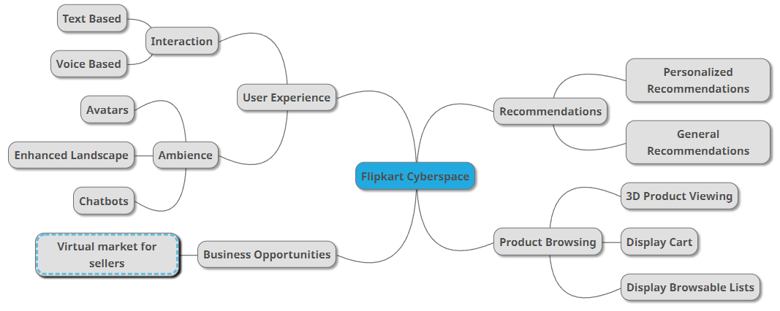
Solution Mind Map
Problem: There is a need for a virtual shopping complex, where users can come, and shop for the products they need. Also, we need to display to the users various products that they might like. Also, the virtual space must be so designed that it attracts users, thereby increasing potential sales.

Slide 11
User Experience
The users are provided with a virtual space, where they can meet, interact, and shop.
The users get to experience the ambience and real life feel of a shopping market while scrolling through their screens and sitting on their couch.
In the comfort of their homes, they can shop in a real time environment.
With the features such as Chatbots and live interaction with strangers during shopping will give an essence of shopping that is not available through static sites.
Business Opportunities
The Cyberspace will help businesses promote their services and offerings effectively.
The shop owners will be able to provide a virtual life – like experience to potential customers, via this platform.
Their products can also be showcased in a featured section.
Also, revenue can be generated through various brands via advertisements, through bill – boards.

Slide 12
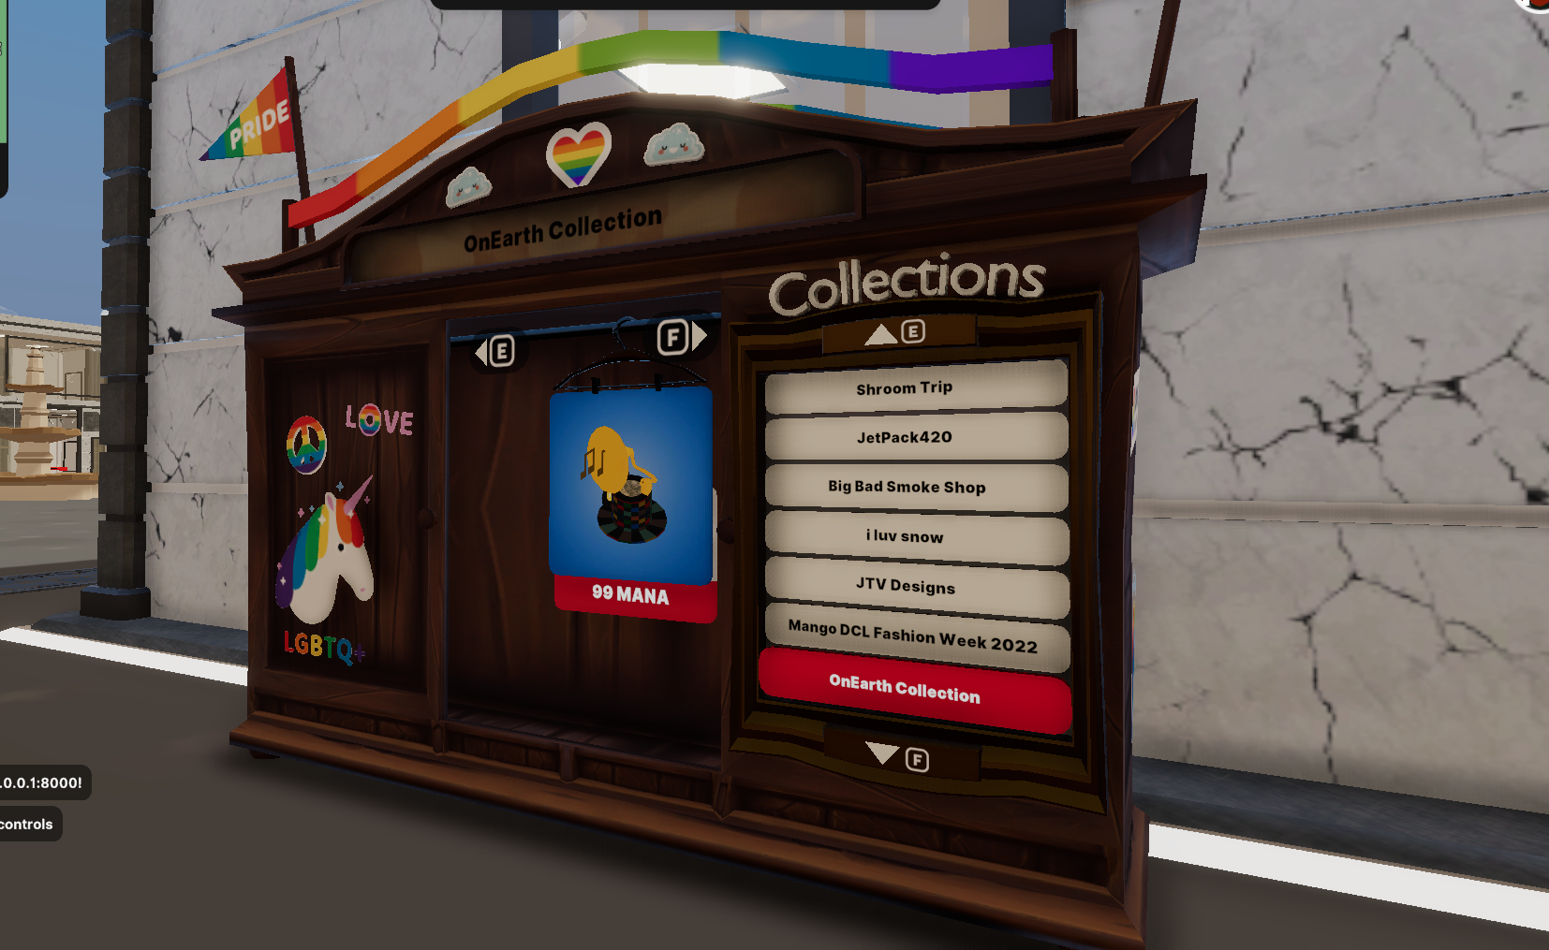

Recommendations
Users will be displayed top recommended products among categories based on a number of aspects.
Personalized recommendations can also be there based on various filters such as prize range, brand preferences, etc. and users previous search history.
Product Browsing
The system contains a component to display the different products the users may be shown, including all the recommendations, and other general products, category – wise.
The users can view the products as 3D models, giving them a better experience as compared to the conventional 2D images available on the e – commerce websites.
We also have planned, as a future scope, a 3D cart for displaying to the users, from within the system. This cart can utilize the same functionality as the list – displaying component.

Slide 13
Limitations
Limited number of products can be displayed.
Increased user traffic necessitates creating different instances of the same Cyberspace for different users.
User network connectivity issues might cause lags in loading and user interaction.
Limited availability of 3D model files (.glb format) for each product.

Slide 14
Future Scope
User sessions can be tracked via a pin unique to the user, and user – specific recommendations can be given.
Blockchain based technology can be integrated into the system.
Users can be given an option to try on the products/view them in AR, via different components.
Gamification aspects, like points can be introduced, that allow users to purchase products via an in – space box.

